Slide 1
Predictive Maintenance Project Summary
Overview of problem, data, EDA, modeling, and deployment

Slide 2
Problem Statement
Predictive maintenance aims to forecast equipment failures before they occur, reducing downtime and maintenance costs. In this project, we focus on base station sensor data to build a model predicting maintenance needs.

Slide 3
Dataset Description
- Data collected from base stations: Temperature, Power Usage, Signal Quality, etc.
- Target variable indicates maintenance/failure events
- Data includes categorical and numerical features requiring preprocessing

Slide 4
Exploratory Data Analysis (EDA) Findings
- Detected class imbalance across maintenance categories
- Outliers observed in temperature and power usage
- Some features strongly correlated (e.g., temperature vs. power)
- Categorical variables need encoding before modeling

Slide 5
Feature Engineering Steps & Justification
- Label encoding for categorical features to convert to numeric values
- Normalization/Scaling for continuous variables if needed
- Aggregating rare classes or combining them to reduce imbalance
- Justification: improves model performance and interpretability

Slide 6
Model Building and Evaluation
- Used RandomForestClassifier as baseline model
- Performed train-test split (80/20)
- Evaluated with classification metrics (accuracy, precision, recall, F1)
- Observed low performance due to class imbalance and target definition

Slide 7
Model Deployment
- Built a Streamlit web application (app.py) to upload new data and run predictions
- Model saved with joblib and loaded in app for real-time inference

Slide 8
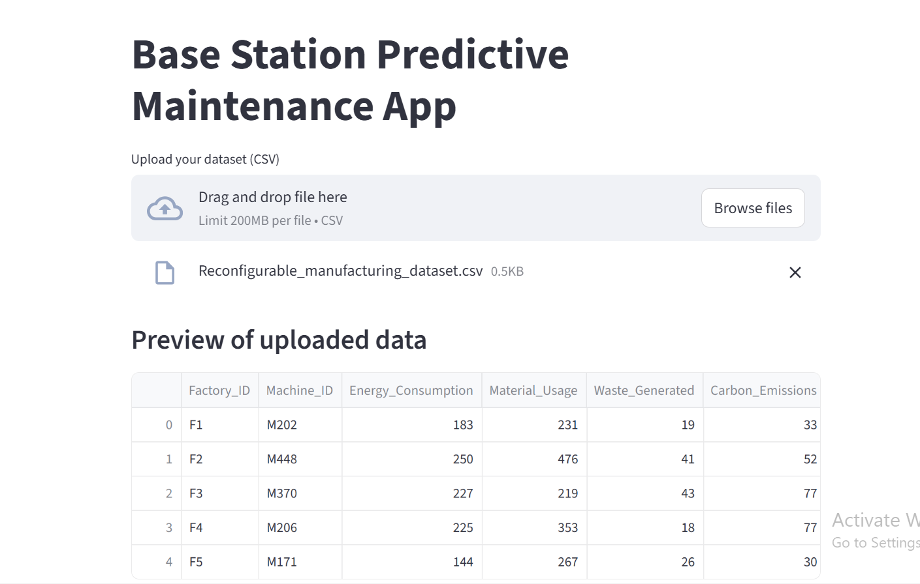
Screanshoot of running model

Slide 9
Thank you

